Slide 1
experimental design
chapter one
canopy structure influences yearly productivity metrics

Slide 2
background
goal: see how forest structure influence metrics of yearly productivity across british columbia at landsat grain
previous research uses terrestrial lidar and canopy rugosity*** as a predictor (Gough et al., 2019; Atkins et al., 2018; Hardiman et al 2011)
this group has used similar methods before, but at very local scales (ne us as max)
custom definition of canopy rugosity as a structural complexity measure

Slide 3
inputs and outputs
inputs: ntems structure datasets
canopy height, cover, and aboveground biomass (possibly vertical complexity)
outputs: dynamic habitat indices (dhis)
cumulative, minimum, variation

Slide 4
current design
~200 randomly* placed samples per forest type and bec zone
run SEM on them
methods: stratified sampling in sgsR (Goodbody et al., 2022)
strata are forest type and bec zone
*randomly includes a set of rules, where within a given focal cell, it is first surrounded by the same strata. if there are not enough pixels available, then it is random outside of this ruleset

Slide 5
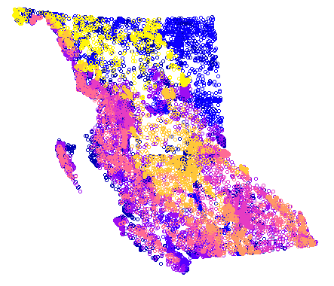
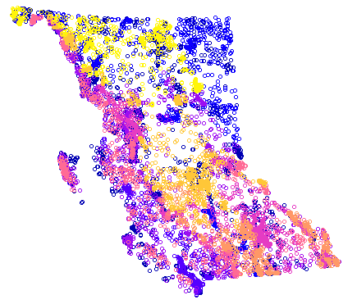
size issues
sample
tiling leads to condensed points in parts of the province (i.e. vancouver island)
workaround: minimum sampling distance of 1km
thoughts?
subsample

Slide 6
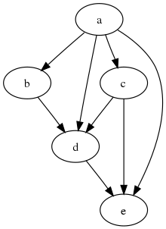
methods
structural equation modelling
multivariate causal models
directed acyclic graph
statistical framework, not engine

Slide 7
stuctural equation modelling
models:
dhi ~ height + cover + agb
agb ~ height
cover ~ height
what it means:
dhi is influenced by height, cover and agb
cover and agb are influenced by height

Slide 8

latent variables
dhi ~ complexity + height
complexity ~ agb + cover + height
agb should likely be our vertical complexity metrics
height
canopy complexity (latent)
dhi
cover
agb

Slide 9
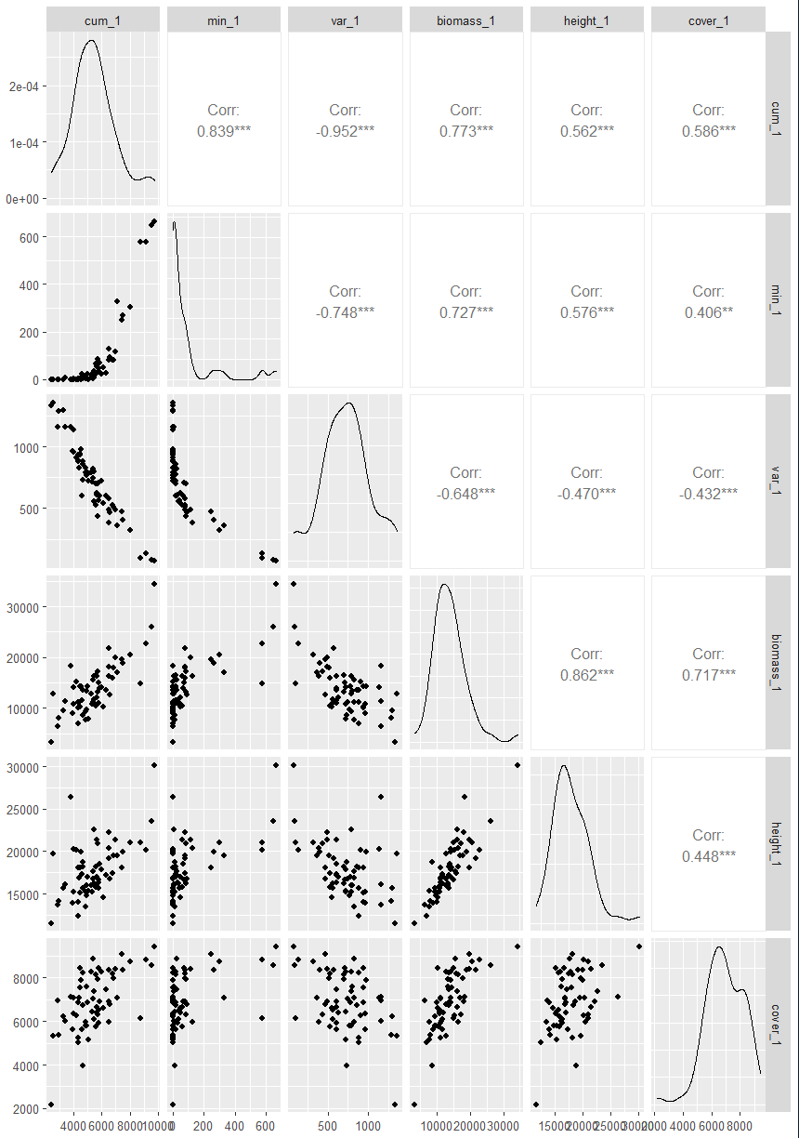
correlations between varaibles

